Slide 1
Chapter 8
Network Layer – Part 3
(Subnetting)

Slide 2

Objectives
What is subnetting?
Purposes of subnetting
Subnetting an IPv4 network (Class A, B, C)

Slide 3
Introduction
IPv4 is a hierarchical addressing scheme
There are two levels of hierarchy: a network and a host.
However, as networks grow, the two-level hierarchy is insufficient → subnetting is needed
Subdividing a network adds a level to the network hierarchy, creating three levels: a network, a subnetwork, and a host.

Slide 4

IPv4 address

Slide 5
Subnetting
The process of segmenting a network (either Class A, B or C), by dividing it into multiple smaller network spaces, called SUBNETS (sub networks)
subnet
subnet
subnet
subnet
subnet
subnet

Slide 6
Reasons for Subnetting
Control traffic by containing broadcast traffic within subnetwork instead of one big broadcast domain (create smaller broadcast domain)
Imagine a broadcast operation in Class A network without subnetting
Reduce overall network traffic and improve network performance
Provide improved security by separating one LAN from another.
How a network can be subdivided?
Region
Purposes
Ownership
device types

Slide 7
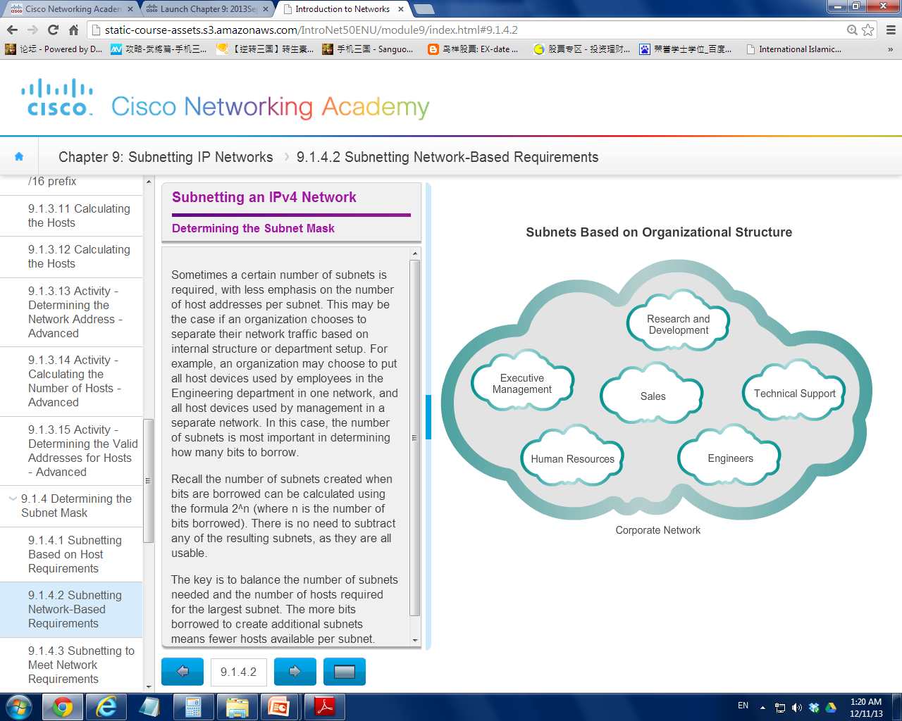

Slide 8
Communication Between Subnets
Similar to normal networks communication, ROUTER is necessary for devices on subnets to communicate.
Each router consists of multiple interfaces.
Each interface is connect to a subnet and the interface is assigned with an IPv4 address that belongs to the subnet
Devices on the subnet use the IPv4 address attached to the interface as their default gateway.

Slide 9
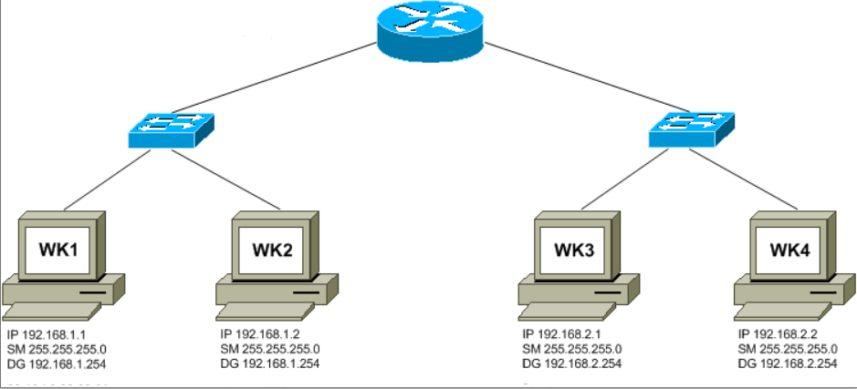
192.168.1.254 /24
192.168.2.254 /24
Subnet 1
Subnet 2

Slide 10
How to create subnets?
IPv4 subnets are created by using one or more of the host bits as network bits. This is done by extending the mask to “borrow” some of the bits from the host portion of the address to create additional network bits.
The more host bits borrowed, the more subnets that can be defined.
However, with each bit borrowed, fewer host addresses are available per subnet.

Slide 11
Subnetting Formulas
Calculating Subnets
2^n (where n = the number of bits borrowed)
Eg. 2^1 = 2 subnets
Calculating Hosts (devices which are assigned with usable IP)
2^n – 2 (where n = the number of bits remaining in the host field)
Eg. 2^7 – 2 = 126 hosts

Slide 12
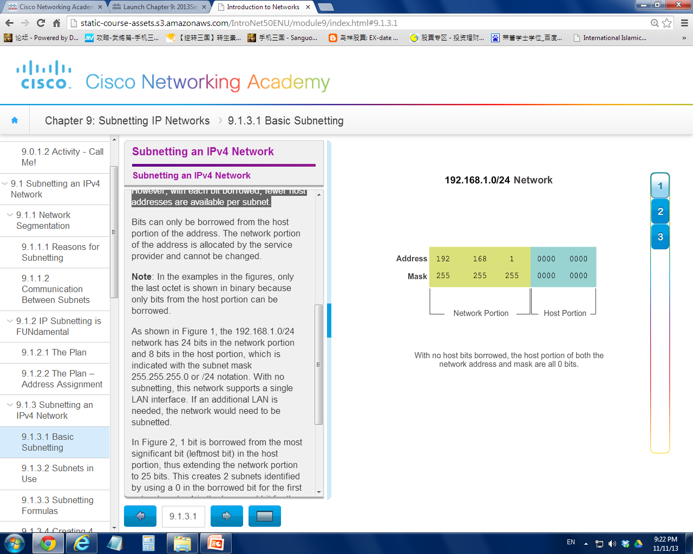

Slide 13

Network Address
192.168.1.0 / 24
a LAN that consists of
max 254 hosts
2^8 – 2 = 254 hosts

Slide 14
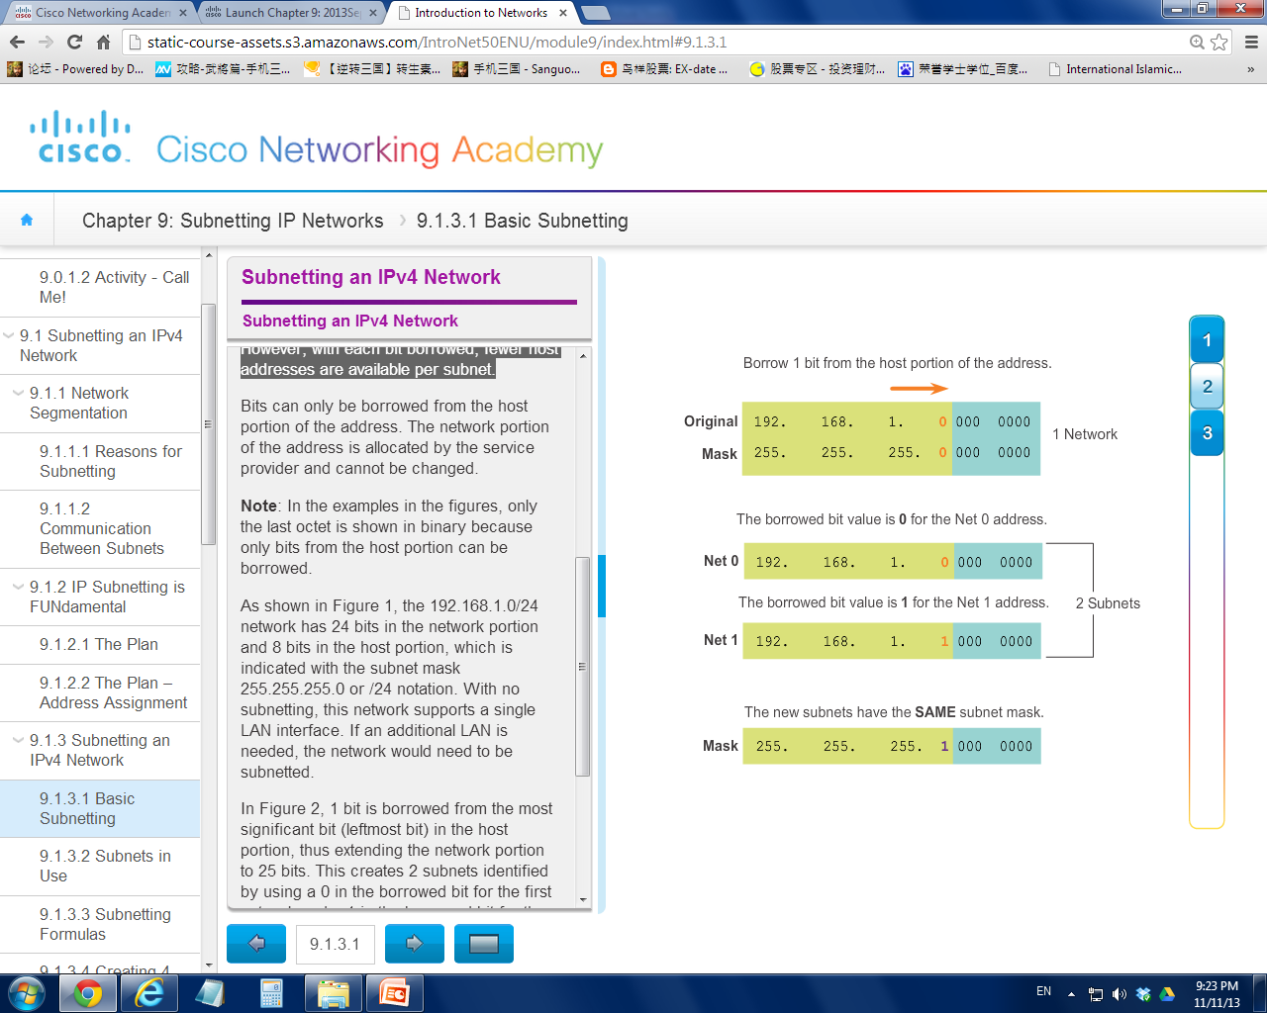
subnet mask must change to reflect the borrowed bits, 255.255.255.128

Slide 15
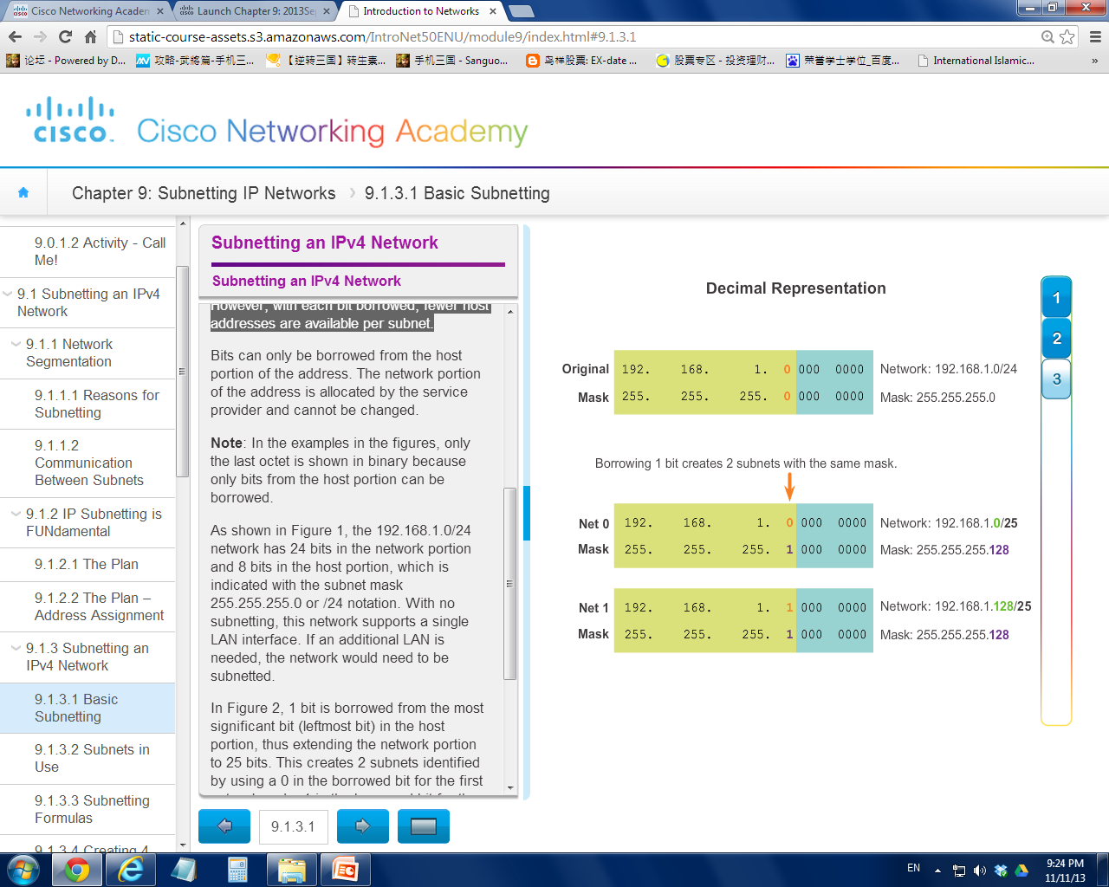
192.168.1.0/24 network was subnetted to create two subnets:
→ 192.168.1.0/25
→ 192.168.1.128/25

Slide 16
Net 1
192.168.1.128 / 25
Net 0
192.168.1.0 / 25
A subnet that consists of 126 hosts
A subnet that consists of 126 hosts
2 subnets
Each has 2^7 – 2 = 126 hosts

Slide 17
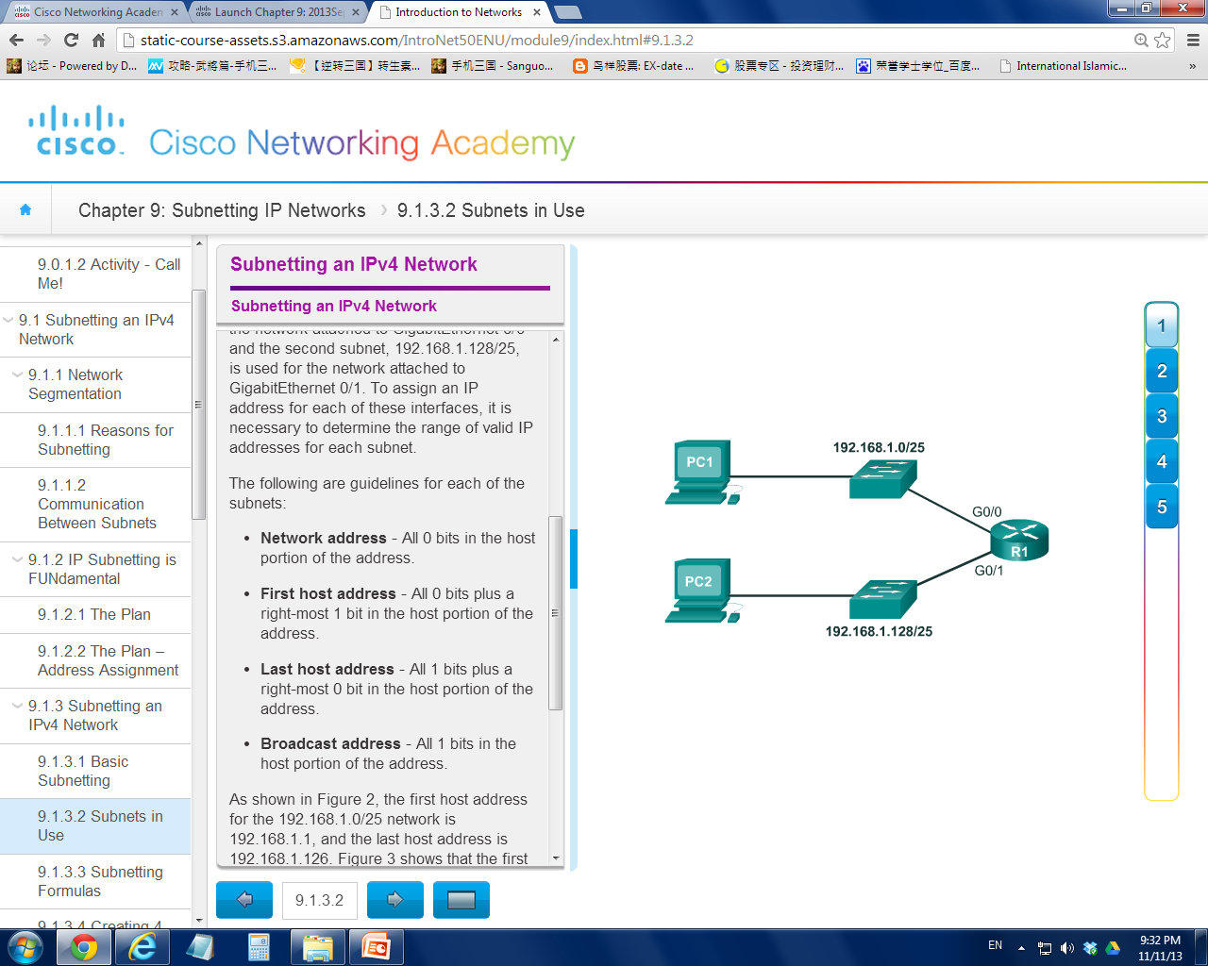
Subnet 0
The subnets share the same router
but with different interfaces
Subnet 1

Slide 18
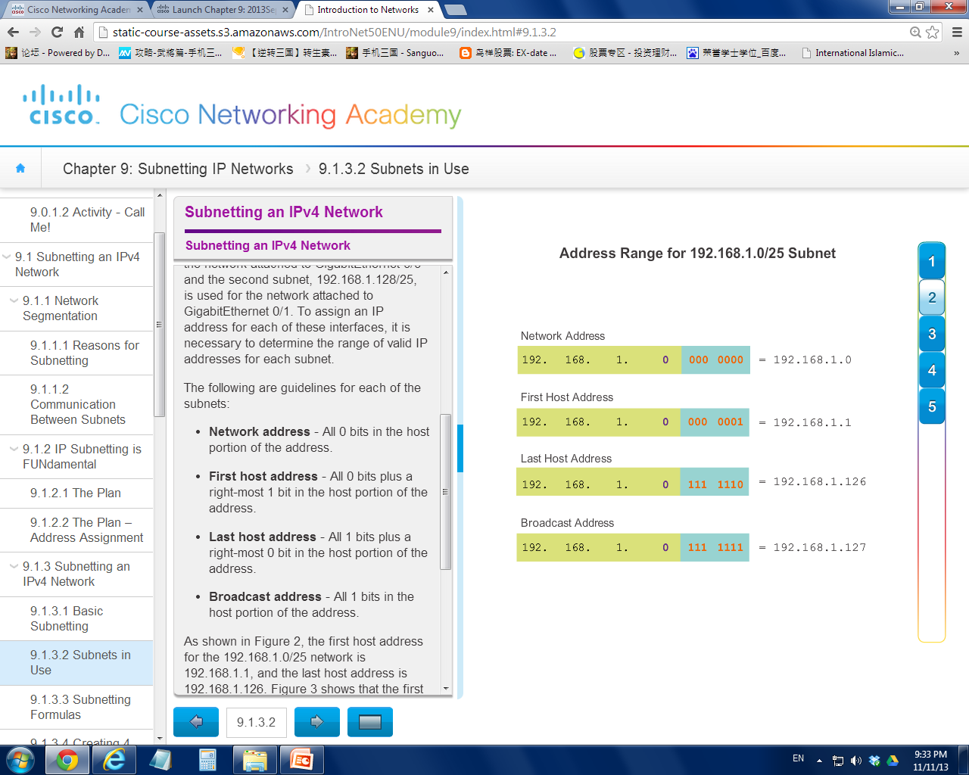
Subnet 0

Slide 19

Subnet 1

Slide 20
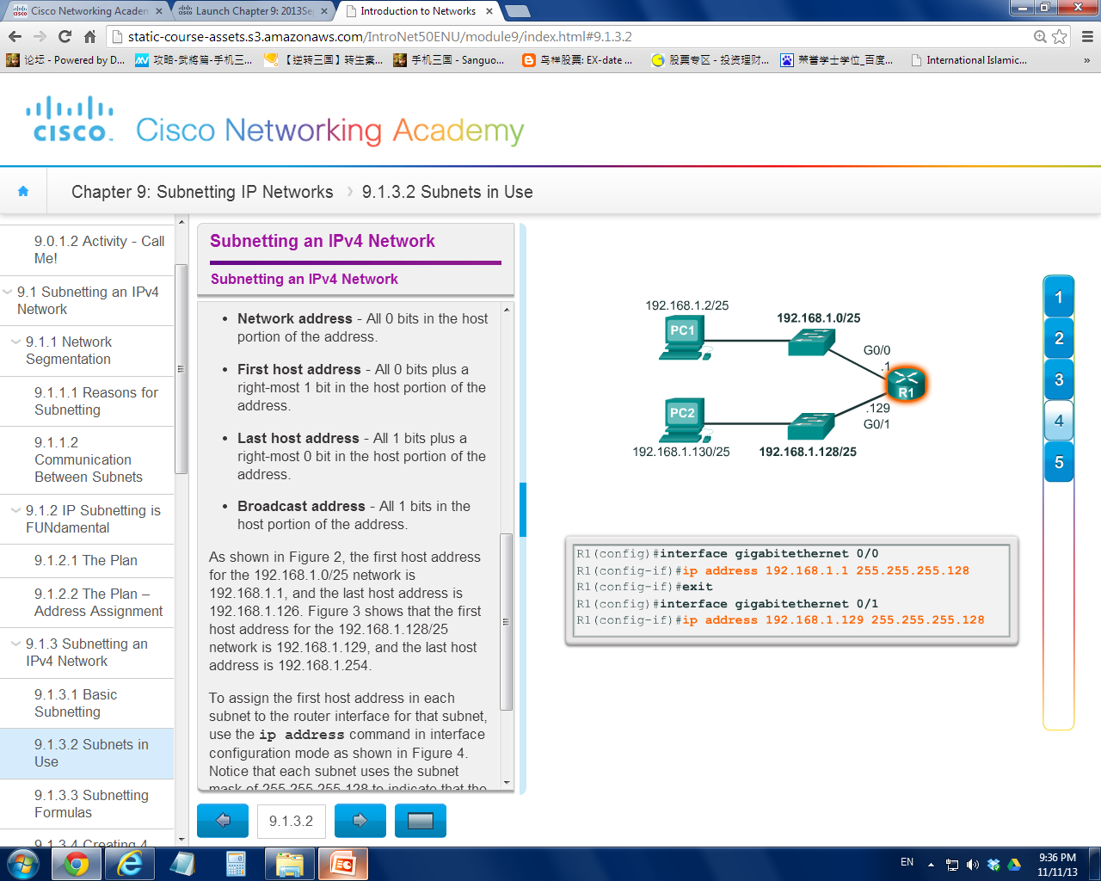
The interfaces consists
of IPv4 addresses that
belong to different
subnets

Slide 21
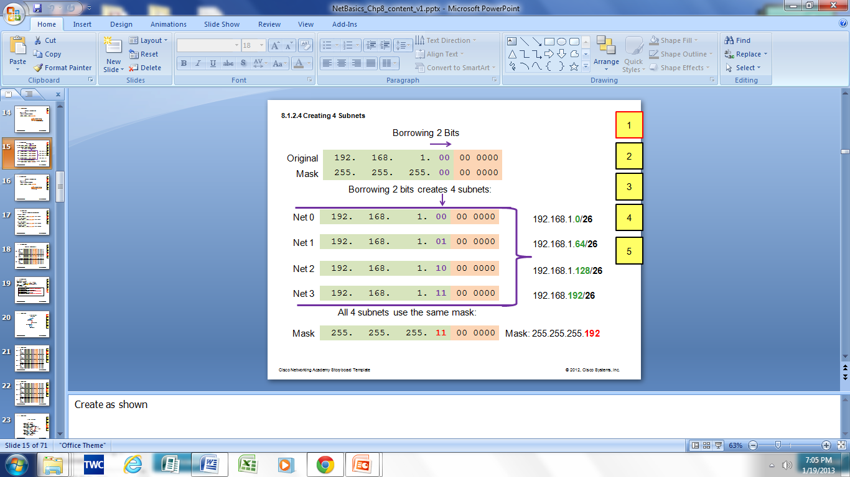
Create 4 subnets
Borrowing 2 bits to create 4 subnets. 2² = 4 subnets

Slide 22
Net 1
192.168.1.64 / 26
Net 0
192.168.1.0 / 26
A subnet that consists of 62 hosts
A subnet that consists of 62 hosts
Net 3
192.168.1.192/ 26
Net 2
192.168.1.128 / 26
A subnet that consists of 62 hosts
A subnet that consists of 62 hosts
4 subnets
Each has 2^6 – 2 = 62 hosts

Slide 23
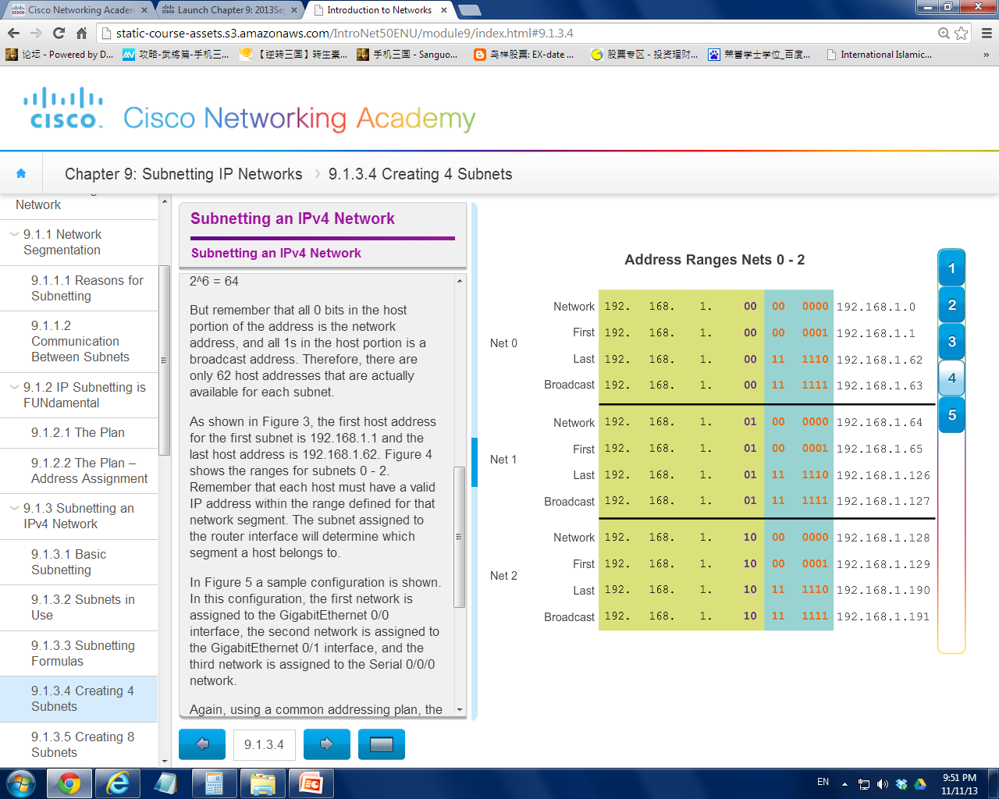
Net 3 Network Address, First Host, Last Host and Broadcast?
192.168.1.192 / 192.168.1.193 / 192.168.1.254 / 192.168.1.255

Slide 24
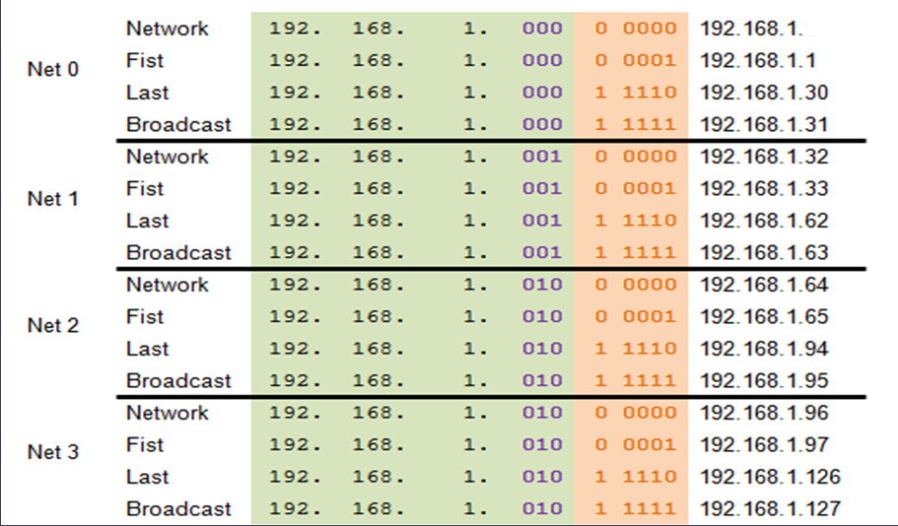
Create 8 subnets
Borrowing 3 bits to Create 8 Subnets. 2³ = 8 subnets
0

Slide 25
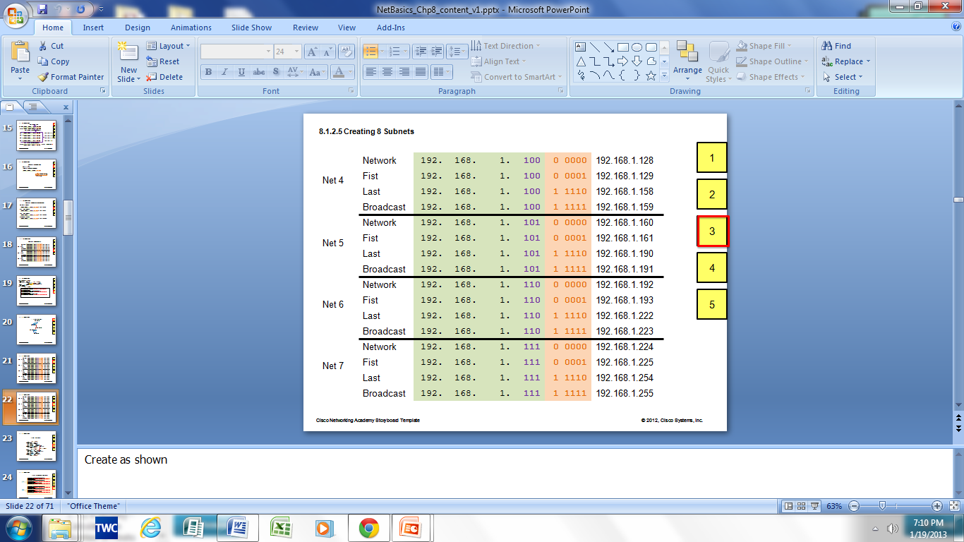

Slide 26
Exercise 1
11000000 10101000 00000001 10000001
Given 192.168.1.129 /27, answer the followings:
Subnet mask in binary format?
Number of bits borrowed?
Number of subnets created? [2^N]
Number of hosts in each subnet? [2^N -2]
Which subnet is this IP belong to? [AND]
What is the broadcast add of this subnet? [Last IP]
11111111 11111111 11111111 11100000
3
8
30
11000000 10101000 00000001 10000000 → 192.168.1.128
11000000 10101000 00000001 10011111 → 192.168.1.159

Slide 27
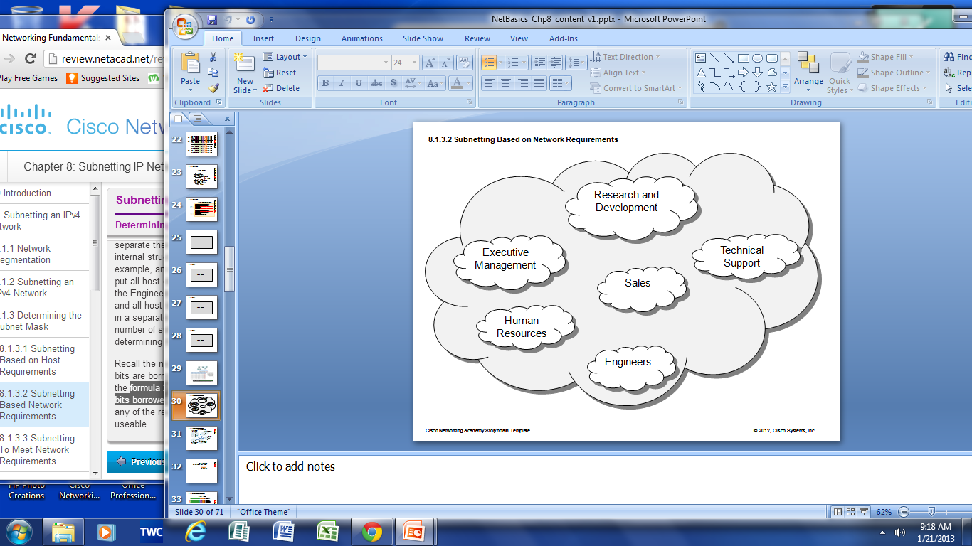
Exercise 2
6 subnets
No. of subnets =
No. of bits borrowed =
3 bits

Slide 28
Exercise 3
Number of needed subnets : 14
Number of needed usable hosts : 14
Network Address : 192.10.10.0
Address class :
Default subnet mask :
Custom subnet mask :
Total number of subnets :
Total number of host addresses :
Number of usable addresses :
Number of bits borrowed :
C
255.255.255.0
255.255.255.240
2 ^ 4 = 16
2 ^ 4 = 16
14
4

Slide 29
Exercise 4
Number of needed subnets : 1000
Number of needed usable hosts : 60
Network Address : 165.100.0.0
Address class :
Default subnet mask :
Custom subnet mask :
Total number of subnets :
Total number of host addresses :
Number of usable addresses :
Number of bits borrowed :
B
255.255.0.0
255.255.255.192
2 ^ 10 = 1024
2 ^ 6 = 64
62
10

Slide 30
Exercise 5
Network Address : 148.75.0.0 /26
Address class :
Default subnet mask :
Custom subnet mask :
Total number of subnets :
Total number of host addresses :
Number of usable addresses :
Number of bits borrowed :
B
255.255.0.0
255.255.255.192
2 ^ 10 = 1024
2 ^ 6 = 64
62
10

Slide 31
Exercise 6
By using 192.168.10.0/24 as example, if an organization requires 100 subnets, what will happen?
How many host bits need to be borrowed?
How many host bits left?
How many available IP addresses for host?
Are the subnet created meaningful?
How this problem is to be solved?
An IP network that has more hosts bits to borrow is required , eg. IP address with a default subnet mask of /16, or 255.255.0.0.
The network portion of the address is allocated by the ISP and cannot be changed. So organizations need to communicate with the ISP so that the ISP would allocate a block of IP addresses using a default mask with enough bits to create the needed subnets.
7 bits
1 bit
0
No

Slide 32
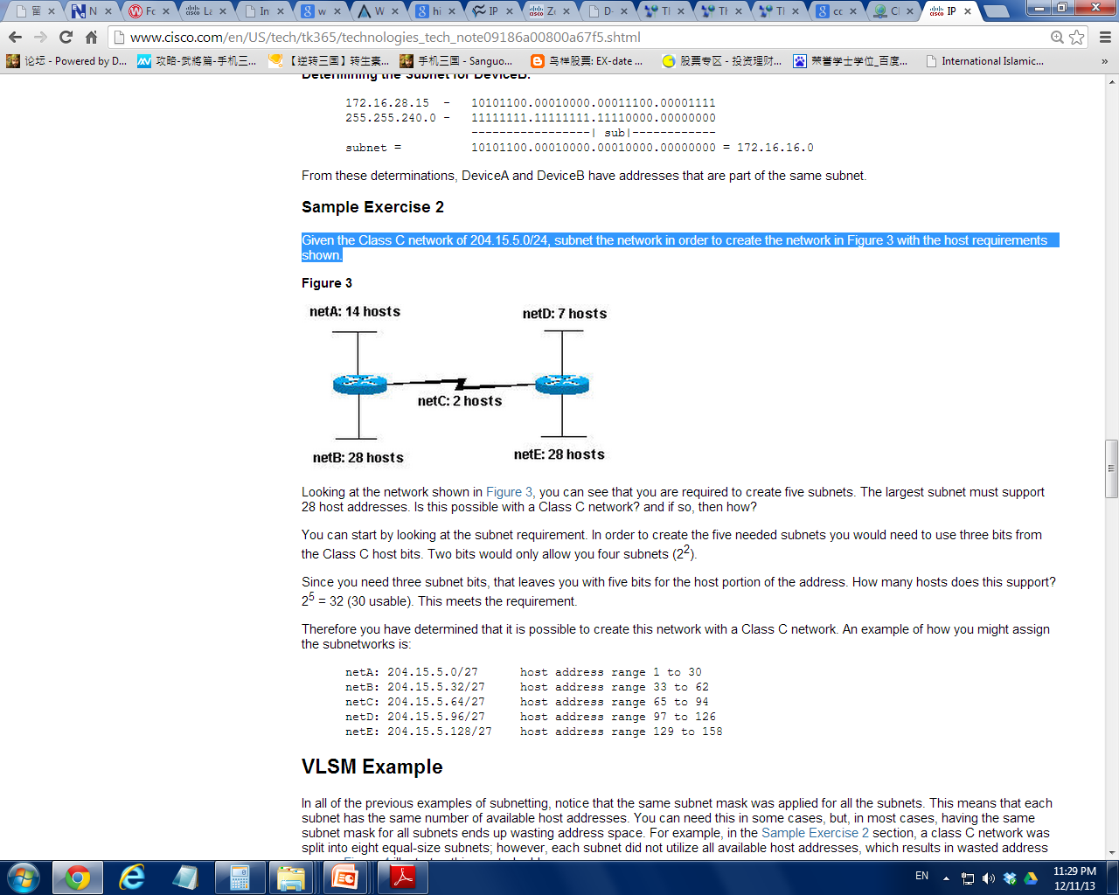
Exercise 7
Given the Class C network of 204.15.5.0/24, subnet the network in order to create the network shown below with the host requirements shown.

Slide 33
Cont’d…
5
How many subnets to create ?
The largest subnet must support how many hosts ?
How many host bits need to borrow?
How many host bits left?
The max host each subnet can support?
Is this possible to achieve with a Class C network?
Show the possible subnetwork addresses
28
3
5
30 (2⁵ -2)
yes

Slide 34
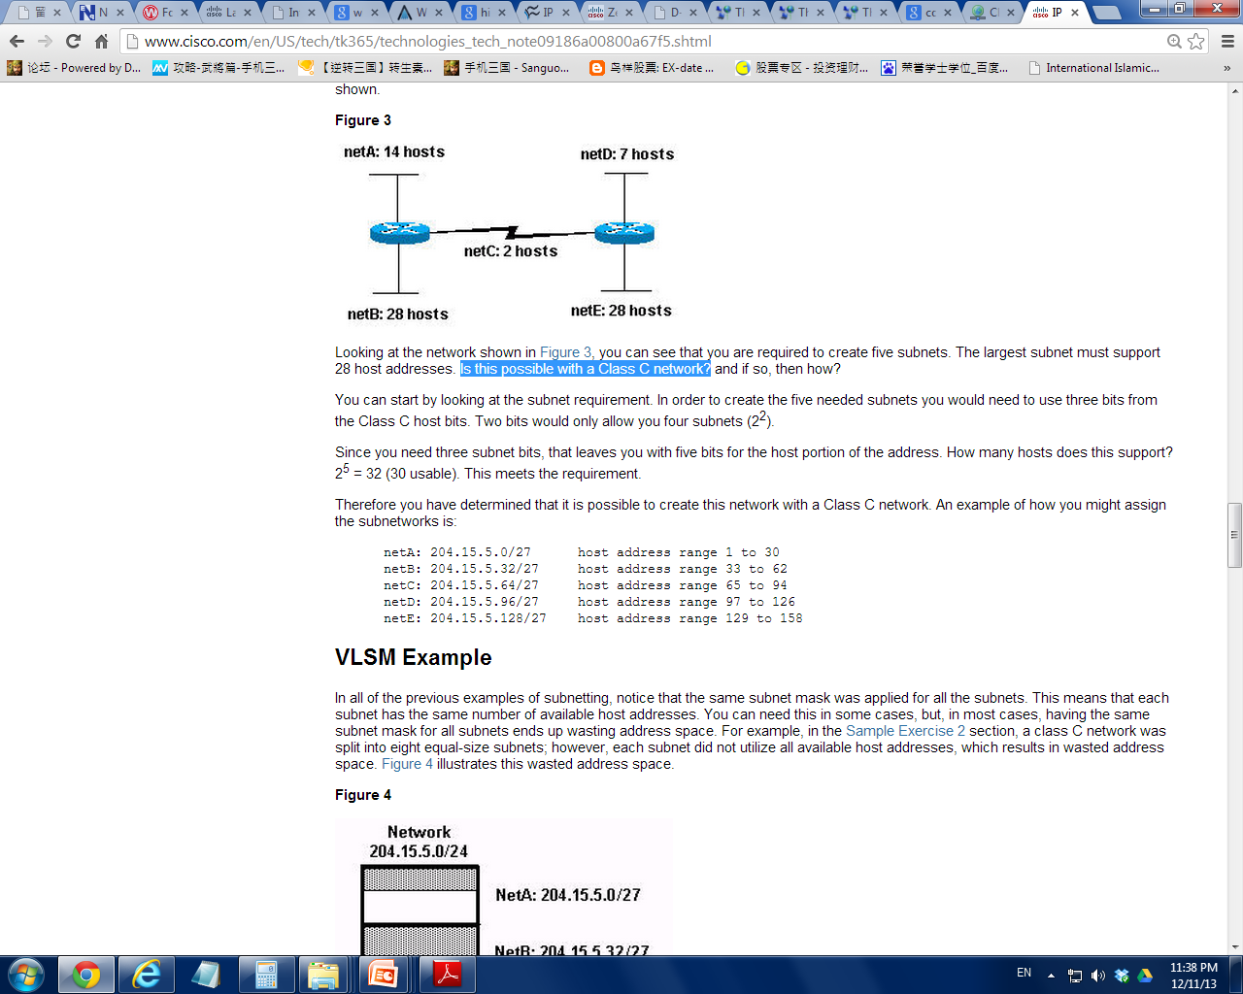

Slide 35
Exercise 8
Number of needed subnets : 14
Number of needed usable hosts : 14
Network Address : 192.10.10.0
Address class :
Default subnet mask :
Custom subnet mask :
Total number of subnets :
Total number of host addresses :
Number of usable addresses :
Number of bits borrowed :
C
255.255.255.0
255.255.255.240
16
16
14
4

Slide 36
Cont’d…
What is the 4th subnet range?
What is the subnet number for the 8th subnet?
What is the subnet broadcast address for the 13th subnet?
What are the assignable addresses for the 9th subnet?

Slide 37
Sample working
0

Slide 38
Cont’d…
240 = 1111 0000
2⁴ = 16 (increment value)
What is the 4th subnet range?
What is the subnet number for the 8th subnet?
What is the subnet broadcast address for the 13th subnet?
What are the assignable addresses for the 9th subnet?
192.10.10.48 – 192.10.10.63
192.10.10.112
192.10.10.207
192.10.10.129 – 192.10.10.142

Slide 39
N0: x.x.x.0
N1: x.x.x.16
N2: x.x.x.32
N3: x.x.x.48
N4: x.x.x.64
N5: x.x.x.80
N6: x.x.x.96
N7: x.x.x.112
N8: x.x.x.128
N9: x.x.x.144
N10: x.x.x.160
N11: x.x.x.176
N12: x.x.x.192
N13: x.x.x.208
N14: x.x.x.224
N15: x.x.x.240
Increment factor = 16
(in fourth octet)

Slide 40
Exercise 9
Number of needed subnets : 1000
Number of needed usable hosts : 60
Network Address : 165.100.0.0
Address class :
Default subnet mask :
Custom subnet mask :
Total number of subnets
Total number of host addresses :
Number of usable addresses :
Number of bits borrowed :
B
255.255.0.0
255.255.255.192
1024
64
62
10

Slide 41
Cont’d…
192 = 1100 0000
2⁶ = 64 (increment value)
What is the 15th subnet range?
What is the subnet number for the 6th subnet?
What is the subnet broadcast address for the 6th subnet?
What are the assignable addresses for the 9th subnet?
165.100.3.128 – 165.100.3.191
165.100.1.64
165.100.1.127
165.100.2.1 – 165.100.2.62

Slide 42
N0 : x.x.0.0
N1 : x.x.0.64
N2 : x.x.0.128
N3 : x.x.0.192
N4 : x.x.1.0
N5 : x.x.1.64
N6 : x.x.1.128
N7 : x.x.1.192
N8 : x.x.2.0
N9 : x.x.2.64
N10 : x.x.2.128
N11 : x.x.2.192
N12 : x.x.3.0
N13 : x.x.3.64
N14 : x.x.3.128
N15 : x.x.3.192
N16 : x.x.4.0
…..
…..
N1023 : x.x.255.192
Increment factor = 64
(in forth octet)

Slide 43
Exercise 10
We have a computer with an IP Address of 192.168.1.127 with a Subnet Mask of 255.255.255.224. Is this a valid Host IP Address?
224 = 1110 0000
2⁵ = 32 (increment value)
Net 0 : 192.168.1.0 - 192.168.1.31
Net 1 : 192.168.1.32 - 192.168.1.63
Net 2 : 192.168.1.64 - 192.168.1.95
Net 3 : 192.168.1.96 - 192.168.1.127
Net 4 : 192.168.1.128 – 192.168.1.159

Slide 44
Exercise 11
Network Address : 10.0.0.0
Number of needed subnets : 30
Address class :
Default subnet mask :
Custom subnet mask :
Total number of subnets :
Total number of host addresses :
Number of usable addresses :
Number of bits borrowed :
List the first five subnets :
A
255.0.0.0
255.248.0.0
2 ^ 5 = 32
2 ^ 19 = 524288
[2 ^ 19] – 2 = 524286
5

Slide 45
248 = 1111 1000 (2nd octet)
2³ = 8 (increment value)
N0 : x.0.0.0
N1 : x.8.0.0
N2 : x.16.0.0
N3 : x.24.0.0
N4 : x.32.0.0
…..
…..
…..
What is the 1st subnet range?
What is the broadcast address for 3rd subnet?
10.0.0.0 – 10.7.255.255
10.23.255.255

Slide 46
Exercise 12 & 13
Create Subnets based on the number of hosts needed
Refer to IPv4 and subnetting workbook
- pg 44 (Subnetting Problem 9)
- pg 48 (Subnetting Problem 11)

Slide 47
Summary
What is subnetting?
Purposes of subnetting
Subnetting calculation (Class A, B, C)

